Slide 1
An agent is a lightweight process that usually runs on a deployment-target host
Host 1
HCL Launch
Agent
Target servers
Server
Deployments
Host 2
Agent
Notes:
Agents are processes that run on the target environment. They communicate with the server and perform the automated steps that are defined in a component process.
Usually, an agent runs on the same host where the resources that it handles are located.

Slide 2
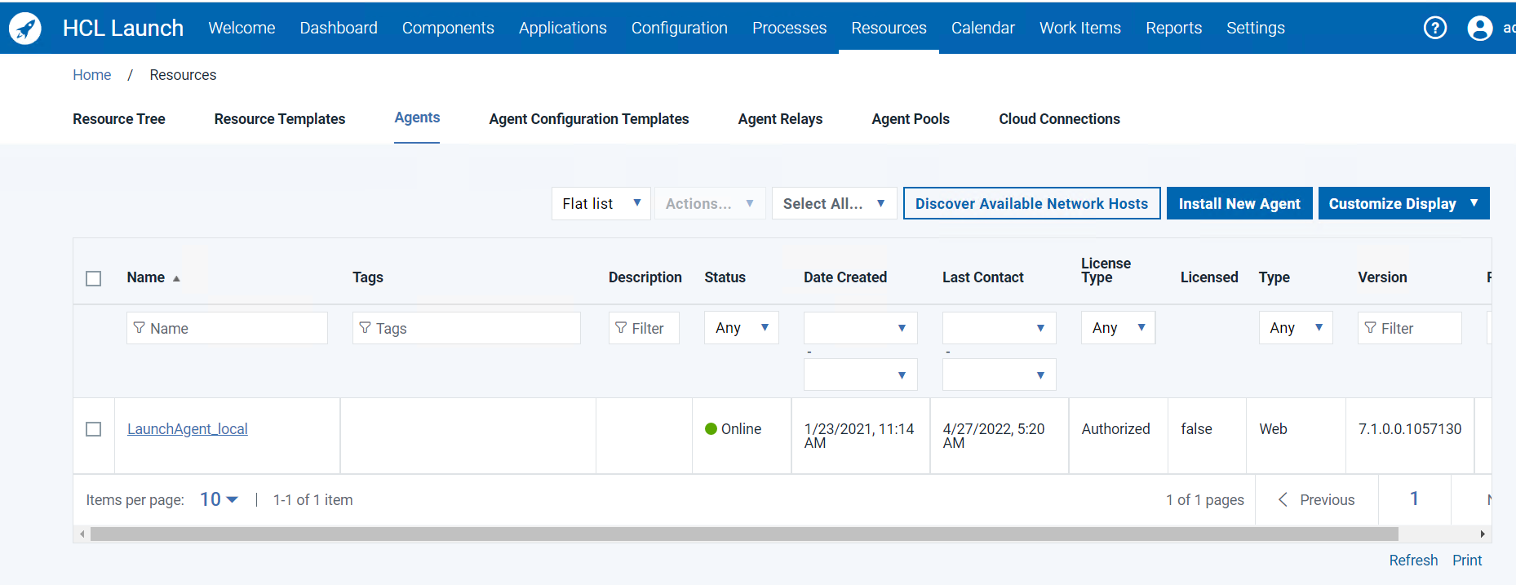
Agents are installed with installation scripts
Notes:
Agents are installed with the installation scripts that are provided with the HCL Launch installation files. When you bring an agent online for the first time, it creates a resource with the same name as the agent.

Slide 3
Agents open direct connections to the server
Server
Agent opens a connection
with the server over WebSocket(Default)
(or) JMS ( Deprecated Now form 7.0 )
Agent uses HTTP to send
the server execution output
PORT (7919
7918)
HTTP(S) (8080, 8443)
Agent
Notes:
When the agent is installed on the deployment target, it opens access to transfer files and execute commands. All processes that the HCL Launch server requests, including packaging, configuration, and deployments, run on hardware that is assigned to agents.
Agent communications employ websocket, HTTP, and HTTPS protocols to communicate with the server. First, the agent uses websocket to establish a connection with the server. Over websocket, the server instructs the agent to run a plug-in step and provides a URL for HTTP connectivity. The agent downloads the required plug-in, runs the step, and then sends execution output back to the server over HTTP.

Slide 4
An agent consists of a worker process and a monitor process
Server
Agent opens a connection
with the server over WebSocket(Default)
(or) JMS (Deprecated from 7.0)
Agent uses HTTP to send
the server execution output
PORT (7919
7918)
HTTP(S) (8080, 8443)
Agent
Plug-in
steps
Worker
(Websocket)
Monitor
Notes:
Although an agent is typically considered a single process, an agent consists of both a worker process and a monitor process.
The worker process runs the deployment work after it receives commands from the server. Work commands come from plug-in steps. The worker process uses websocket for system communications and HTTP REST services when it completes plug-in steps or retrieves information from the server.
JMS protocol is deprecated from 7.0 version .
The monitor process is a service that manages the worker process by starting and stopping, handling restarts, upgrades, and security. The agent monitor service uses Websocket for all server communications and for sending commands, such as the run step command, to the worker process.

Slide 5
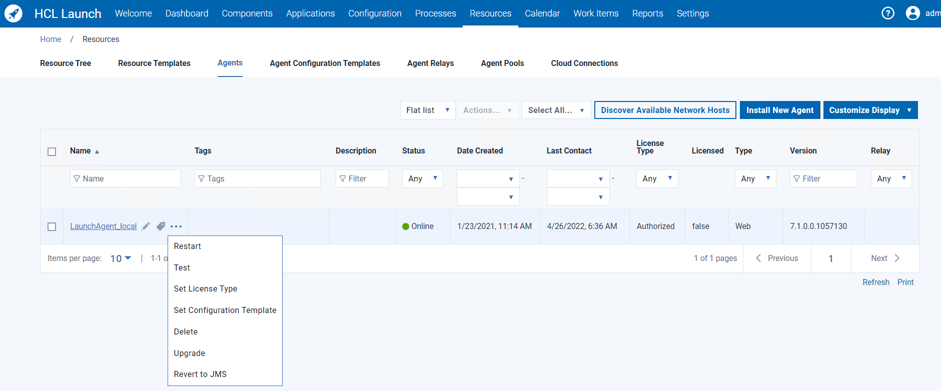
Many agent features are managed from Launch
Manage agent remotely
Agent status
Notes:
After an agent is installed, you can manage many of its features from the Resources tab with the monitor process. You can edit, restart, upgrade, test, inactivate, or delete the agent.
Agents must be online in order to run deployments.
In the status column, you view its state:
Offline: No connection
Connecting: Websocket connectivity is available, but there is no HTTP connection. When an agent is in this state, the server can send a signal for upgrade or restart.
Online: HTTP and JMS connectivity

Slide 6
Agent relays coordinate communication between agents and the server –JMS Agents
Network A
Network B
JMS (7916), HTTP proxy (20008), Artifact caching (20081)
Agent
JMS (7918)
Agent Relay
7916, 20008, 20081
Server
HTTP(S)
(8080, 8443)
Agent
7916, 20008, 20081
Agent
Firewall
Notes:
In simple configurations, agents communicate directly with the HCL launch server, like we just talked about. In more complex situations, this communication becomes inefficient or impossible. Some examples are when the number of agents increase from tens to hundreds to thousands, network topology becomes complex, or agent-server communication crosses firewalls with port restrictions.
The Agent Relay helps alleviate these challenges by consolidating agent traffic and communicating with remote agents.
They can connect large groups of agents to the primary server: Instead of each agent connecting directly to the server, agents connect to agent relays, which are then connect directly to the server. Using agent relays in this way reduces load on the server because the server has fewer direct connections.
They can simplify communication across networks and firewalls: If multiple agents are in a remote network without an agent relay, each agent must connect to the server individually. In this case, each agent must have network permission to connect to the server, including firewall permissions. With an agent relay, the agents connect only to the relay, and the relay is the only system that contacts the server directly, such as with a VPN or tunnel.
The diagram shows the main default ports that are involved in communication between agents, agent relays, and the server.

Slide 7
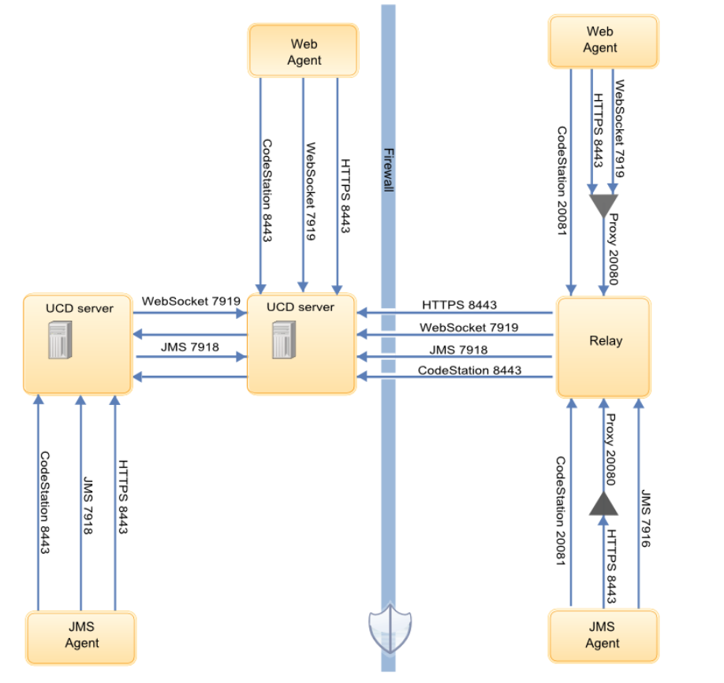
Agent relays coordinate communication between agents and the server –JMS & Web
Notes:
This images explains the Topology of communication between HCL Launch Server , Agent Relay and HCL Launch Agents .

