Slide 1
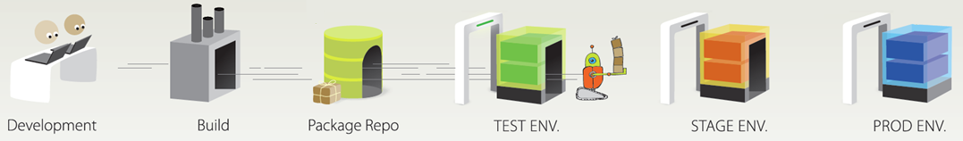
A deployment is the promotion of an application from one environment to the next
DEPLOYMENTS
Notes:
Deployment is the promotion of an application from one environment to the next.

Slide 2
A deployment configures and installs a deployment package in a specific environment
HCL Launch
DEV
Server
Agent
CodeStation
Deployment
DB 1.1
WEB 1.1
APP 1.0
DB 1.1
WEB 1.1
APP 1.0
Notes:
HCL Launch server provides a file transfer capability for deploying files to target servers. A deployment involves selecting component versions from a repository, moving those components to the target server, and completing the required tasks for bringing those parts of the application online.

Slide 3
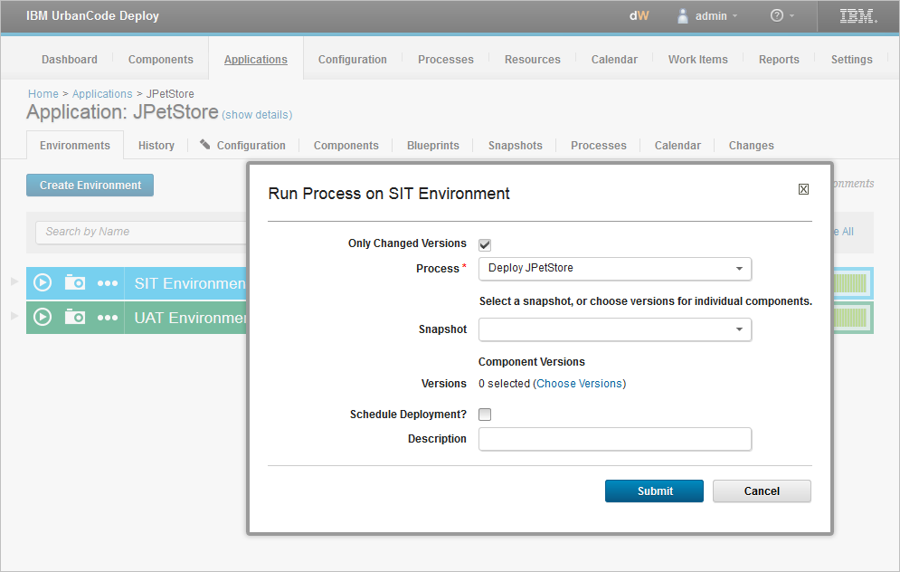
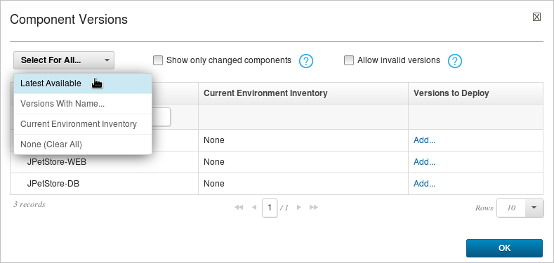
You run a deployment by running an application process in a target environment
Notes:
When you start a deployment, you identify the application process and the component versions to deploy. You can select any process that is defined for the parent application, and you can use any components that are associated with the application.
If you want to deploy only the changed versions since the previous deployment, select the Only Changed Versions check box. If you uncheck this check box, all of the component versions that you select are deployed, even if they are already in the inventory.

Slide 4
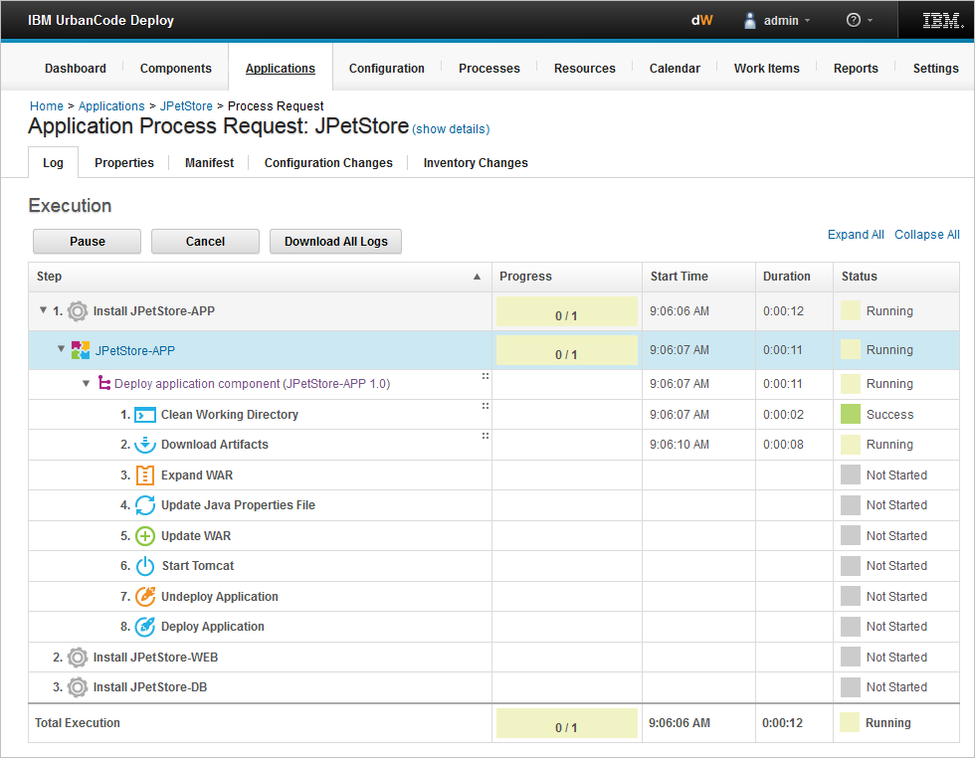
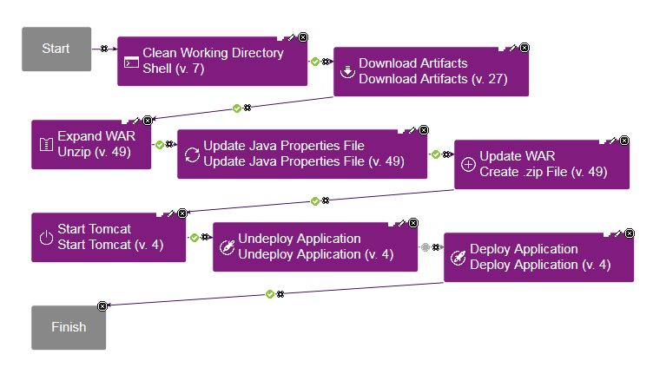
The application process request shows each step in the process
Notes:
When an application process starts, the Application Process Request page displays information about the deployment status. Notice that the steps in the log are the same as the component process.

Slide 5
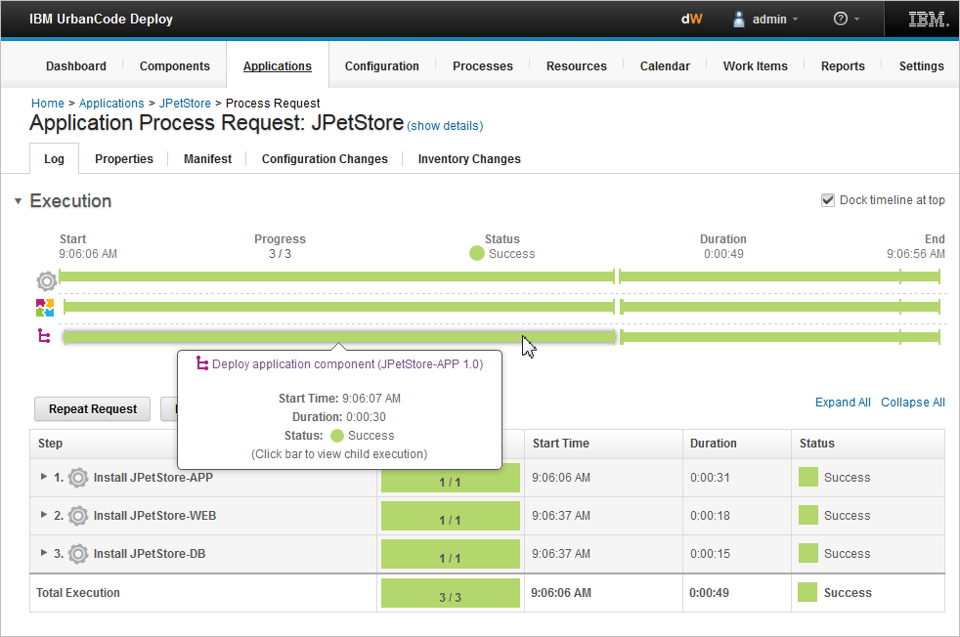
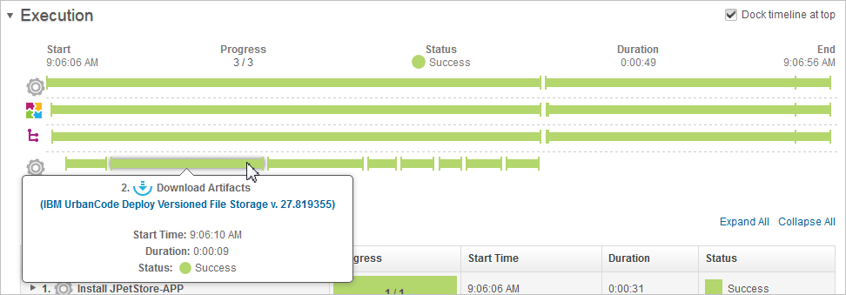
The Execution section displays the deployment details
Notes:
After a process finishes, the Execution section shows the status. You can click on the bars to get more details about the processes and steps.

Slide 6
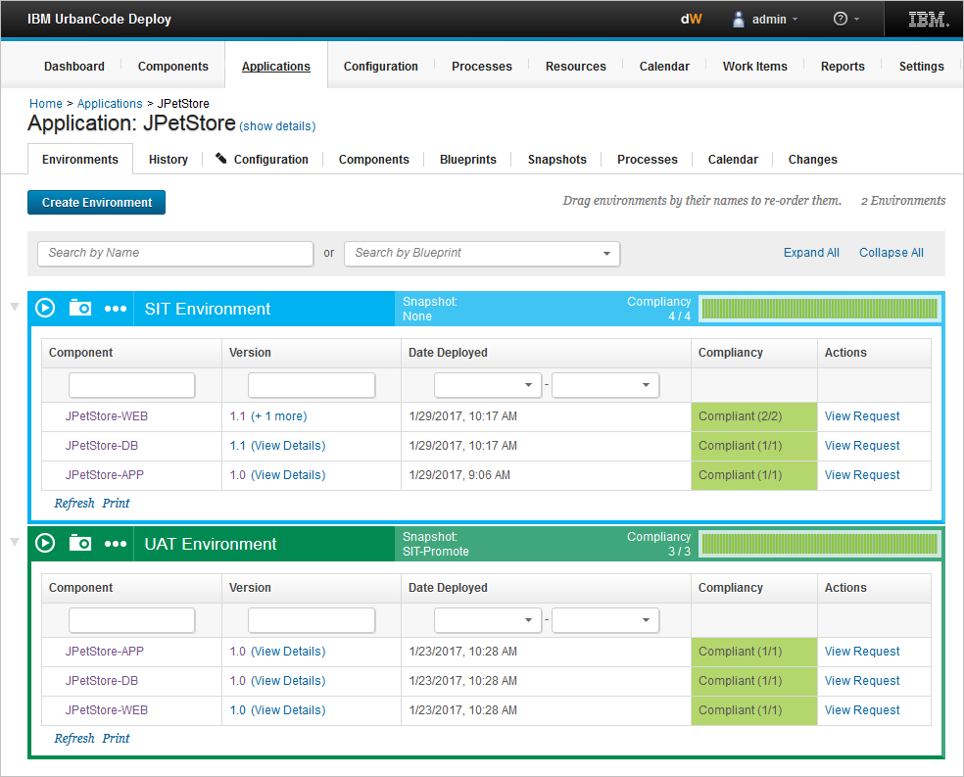
Inventory and history are retained for environments and resources
Shows which component versions are deployed on the environment
Compliancy shows whether actual component inventory matches expected inventory
Notes:
From the Environments tab of an application, you can see that there’s an inventory system. The inventory system tracks the desired state of each environment and what has been successfully deployed to each target resource. Compliancy indicates whether the environment contains those component versions.
The inventory and compliance for an environment are updated each time that you run an application process or deploy a snapshot to the environment.
In this example, there are three deployable components that are deployed to two environments. You can see that the SIT environment has newer versions.

Slide 7
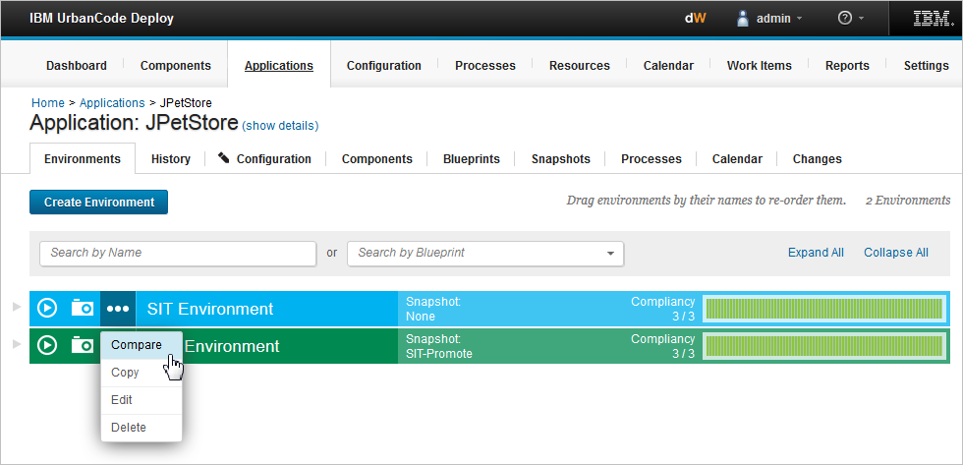
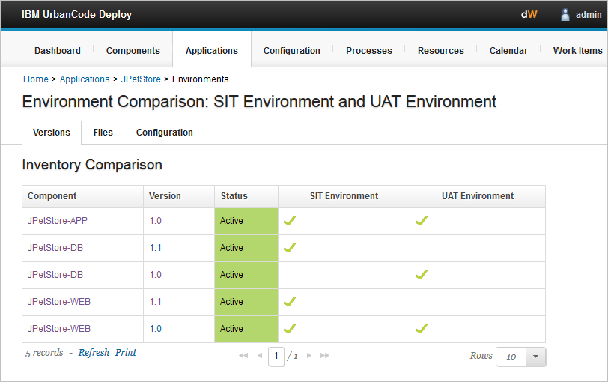
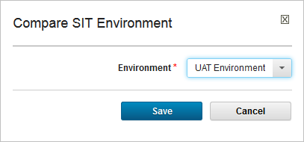
You can compare inventories between environments
Notes:
HCL Launch maintains an inventory of every artifact that is deployed to each environment and also tracks the differences between them. You can compare two environments to see differences in the versions that they contain.

Slide 8
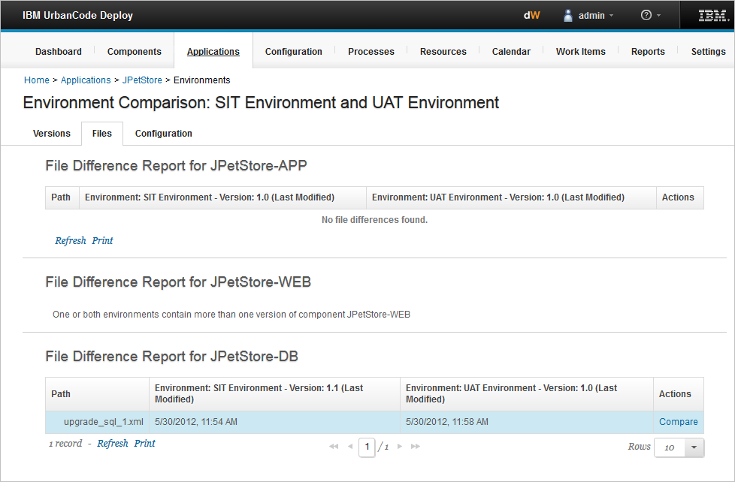
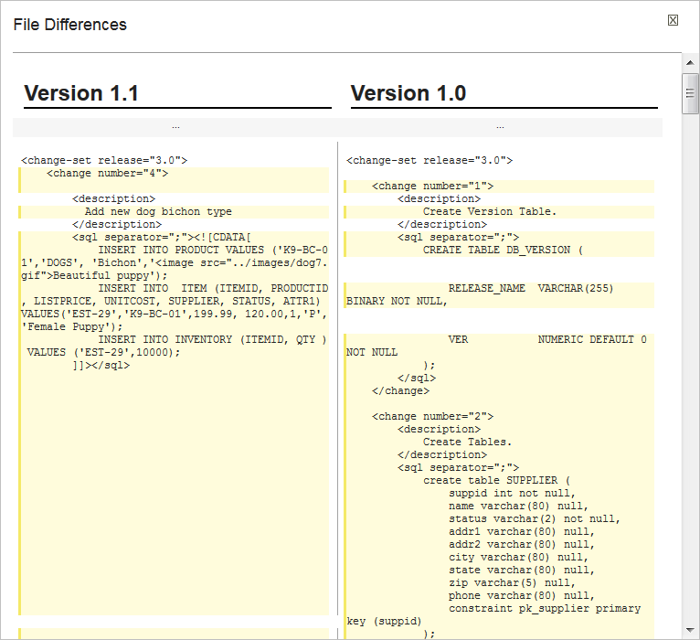
File differences are tracked between the environments
Notes:
When there is a problem in production or during testing, traceability makes it easier to understand what changes are going in that could have caused the problem.

Slide 9
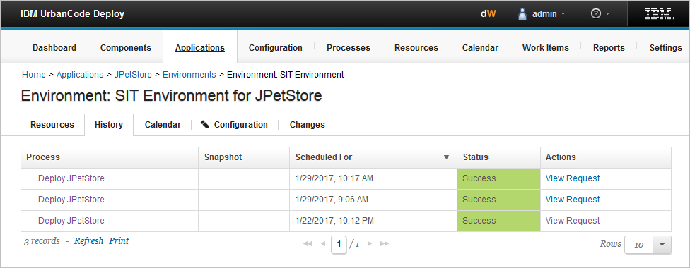
The History tab show the process requests for a specific environment
Opens process request
Notes:
You can view the progress of the process by going to the History tab and opening the process request.

Slide 10
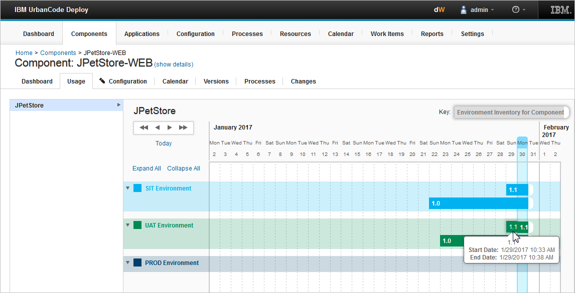
The Usage tab shows the environment inventory for each component
Shows for how long a component was deployed
Environments
Notes:
You can track the environment inventory for each component by clicking the component and then going to the Usage tab. HCL Launch tracks both the version that is currently in an environment and also what was in various environments over time. This is helpful comparing flows through environments and identifying what changed.

Slide 11
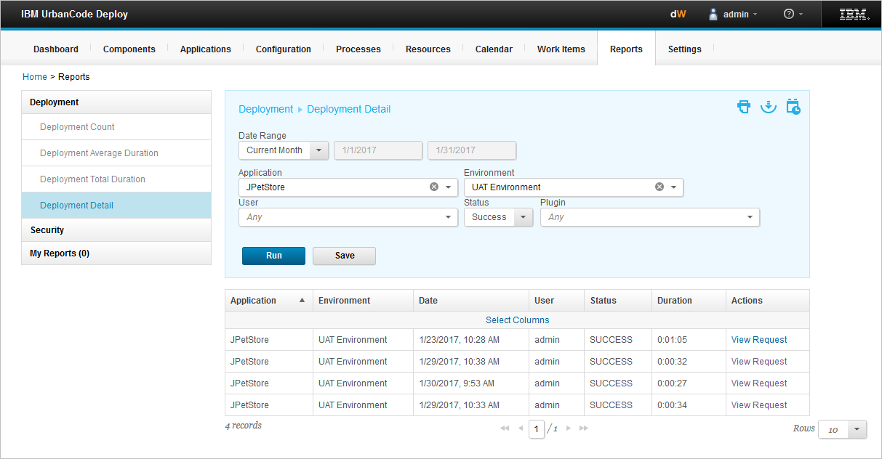
Deployment reports contain historical information about deployments
Choose report type
Select date range and deployment information
Notes:
You can filter data, print and save reports, and save search criteria with deployment reports. You can obtain information for specific reporting periods, such as the number of deployments, average deployment duration, and total duration. In this example, the Deployment Detail report shows all deployments for the specified applications, environments, and users for a given time period.
Deployment count: Provides information about the number of deployments that ran during a specified reporting period.
Deployment average duration: Provides average deployment times for applications that ran during a specified reporting period.
Deployment total duration: Provides total deployment times for applications that ran during a specified reporting period.
Deployment detail: Shows all deployments for the specified applications, environments, and users in the specified time period.

