Slide 1
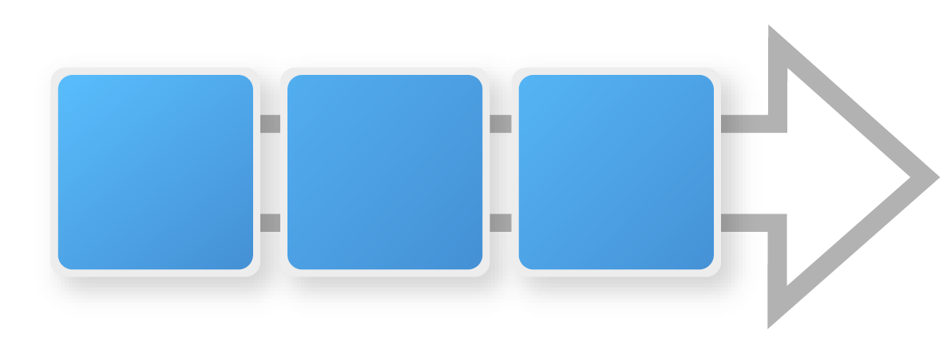
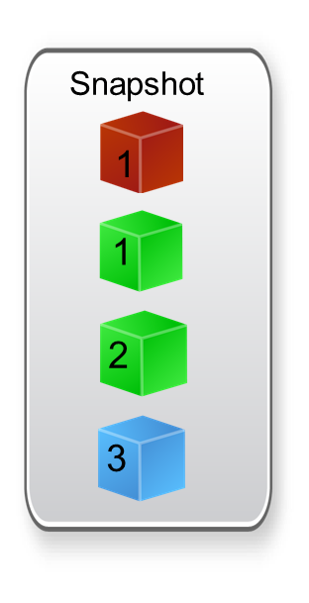
Snapshots / Release Sets promote tested versions ….
Snapshot
Web
1
Mid. Code
1
UAT
Stage
PROD
Mid. Config
2
Promote
Promote
DB
3
Manage a set of tested component versions as a single unit
Guarantee the validated versions of related components are deployed together
Ease of promoting applications between environments
Notes:
Snapshots Ensures higher quality by guaranteeing the correct versions of related components are deployed together
Fast, consistent and repeatable
Same snapshot can be reused across environments
When managing environments and moving applications through them, consistency is what you want.
Snapshots are known good version of the application to deploy to later environments

Slide 2
A snapshot is collection of specific versions of components and processes
Creating a Snapshot
Component Versions
Snapshot
WEB
WEB
1
2
3
3
APP
APP
1
2
3
1
DB
DB
1
2
3
2
Notes:
Snapshots are models that you create before you deploy the application. A snapshot specifies the exact version for each component in the application. When a snapshot is created, information is gathered about the application, including the component versions, for an environment.
Typically, the snapshot is generated in an environment that has no approval gates. This kind of environment is called an uncontrolled environment.

Slide 3
Snapshots ensure consistent deployments from one environment to another
Creating a Snapshot
Snapshot Deployment
SIT Environment
UAT Environment
Component Versions
Snapshot
WEB
WEB
WEB
WEB
1
2
3
3
3
3
APP
APP
APP
APP
1
2
3
1
1
1
DB
DB
DB
DB
1
2
3
2
2
2
Notes:
You use snapshots to ensure the same exact deployment happens from one environment to another. If you have several components, selecting a version for each one, each time, could introduce errors. A snapshot is a single deployable item that you can push from environment to environment. After all the appropriate stages and approvals for a snapshot are complete, the snapshot is pushed to production.

Slide 4
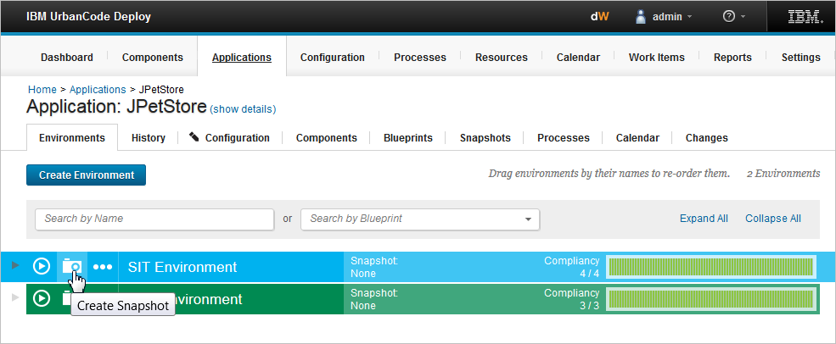
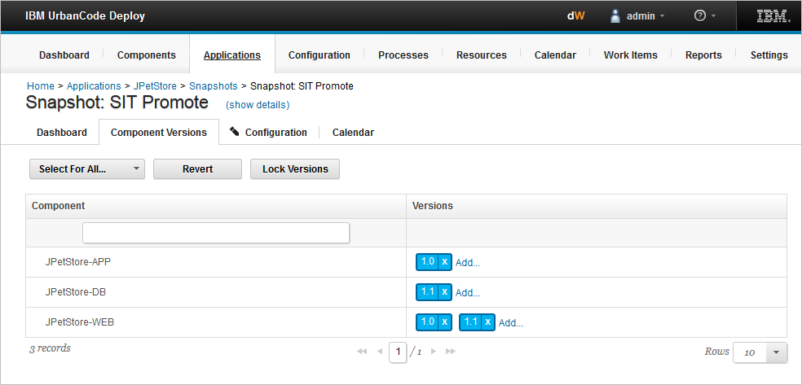
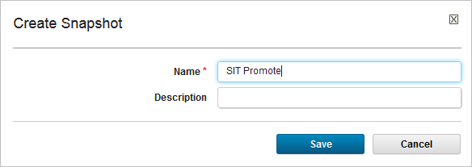
A snapshot captures a picture of the application’s current state
Notes:
To create a snapshot, you choose the component versions and processes to include in the snapshot.

Slide 5
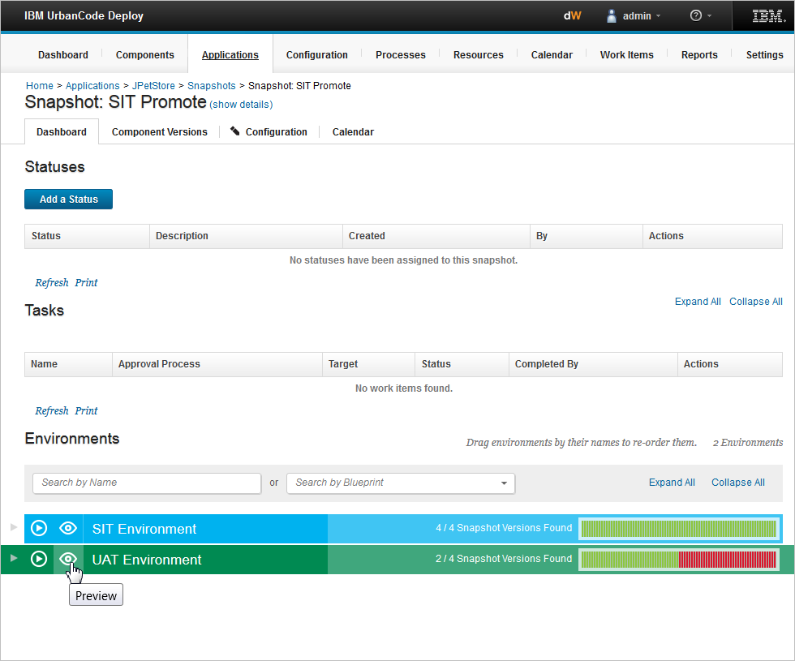
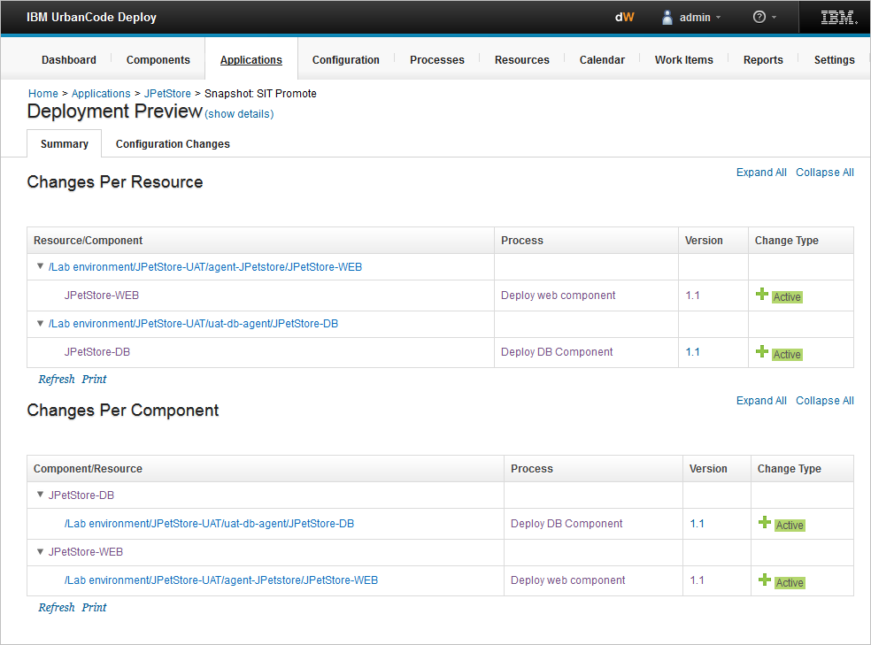
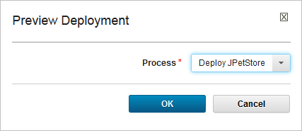
Previewing deployments for impact analysis
Notes:
You can preview an application snapshot before you deploy it to see the upcoming changes in resources and properties.

Slide 6
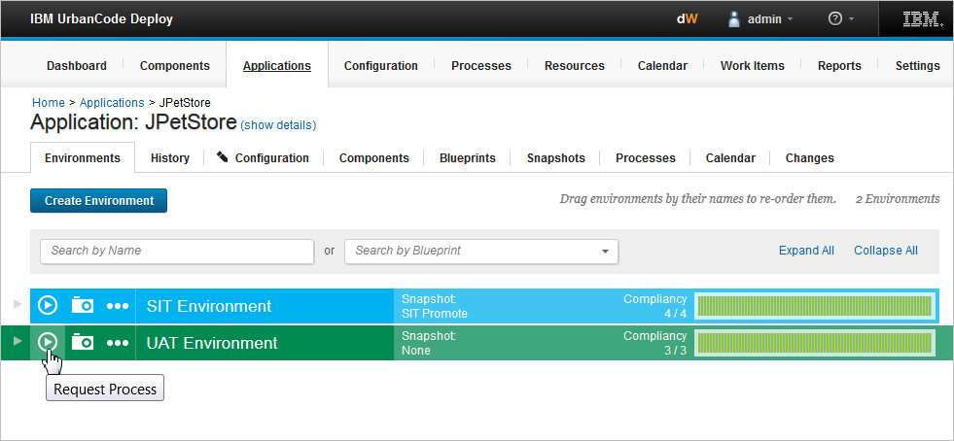
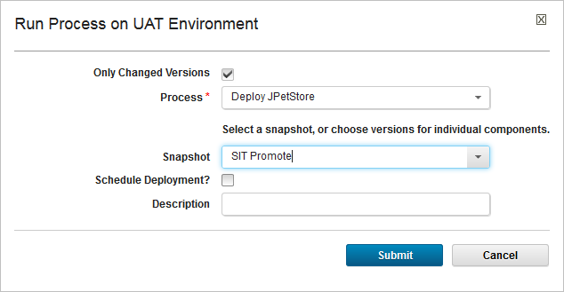
Deploying a snapshot deploys the components in the snapshot
Notes:
When you have a snapshot, you select both the environment to deploy to and the process to use for the deployment.

Slide 7
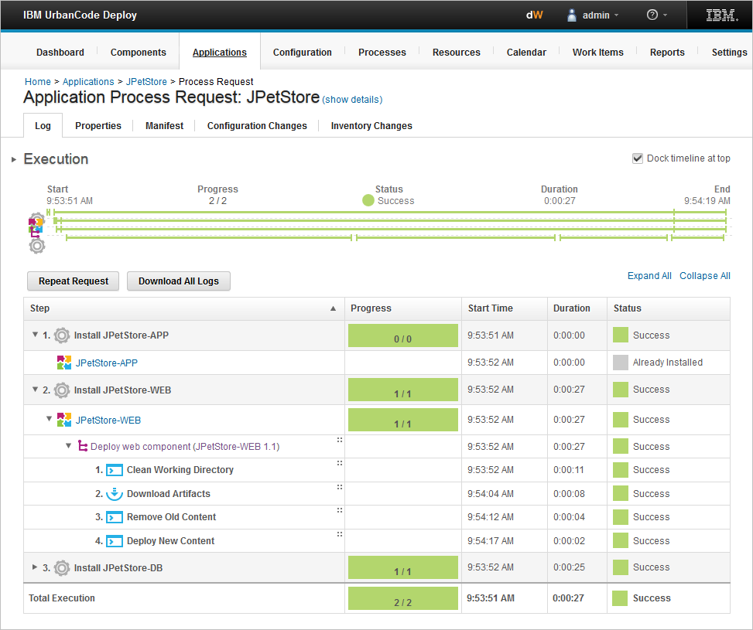
Application and component processes are the same
Same steps from the application and component processes
Notes:
The deployment looks the same as the original deployment each time the snapshot is used.

Slide 8
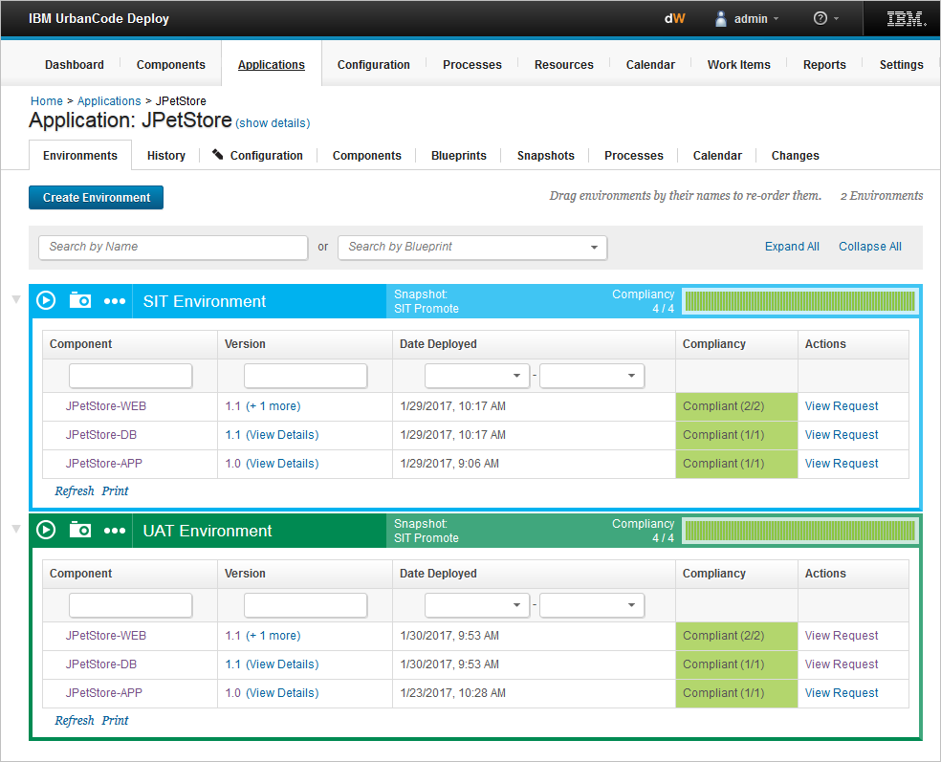
The inventory is updated after running the snapshot
Snapshot created from components and processes in the SIT environment
Snapshot deployed to UAT environment
Notes:
The inventory is immediately updated and can be viewed alongside of other environments in the application.

